Slide 1
ILLUMINA DNA PREP LIBRARY WORKFLOW
Vanessa Natasha
15-07-2035

Slide 2
Introduction to sequencing
Sequencing: a laboratory process that determines the precise order of the four chemical bases (adenine, guanine, cytosine, and thymine) in a nucleic acid molecule (DNA)
Sequencing approaches:
- long read sequencing (1000bp -10,000bp)
short read sequencing (30-500bp)
These approaches also differ in the chemistry/ technology used for sequencing

Slide 3
Sequencing by Synthesis (SBS)
https://www.illumina.com/science/technology/next-generation-sequencing/beginners/ngs-workflow.html

Slide 4
NGS workflow
Step 1: DNA Extraction
Step 2: Library preparation
Step 3: Sequencing
Step 4: Analysis

Slide 5
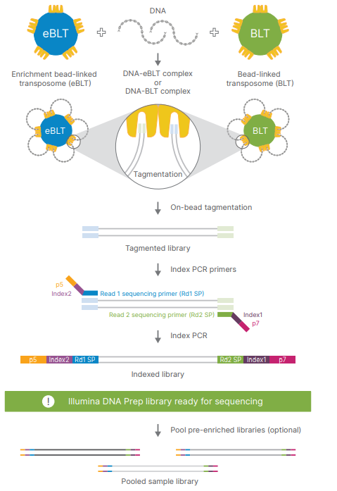
Library Preparation
The library preparation process involves converting a genomic DNA sample (or cDNA sample) into a library of fragments, which can then be sequenced on an NGS instrument

Slide 6
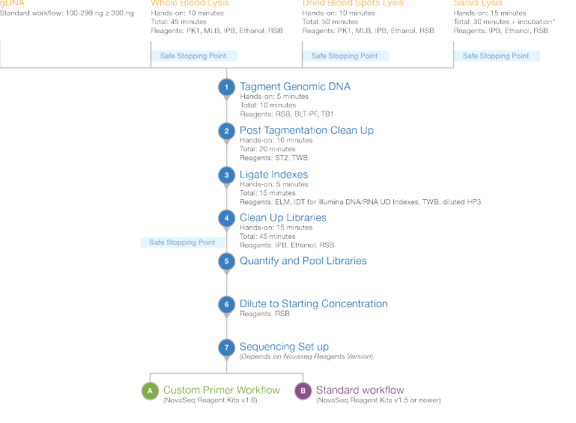
Illumina DNA Prep Workflow

Slide 7
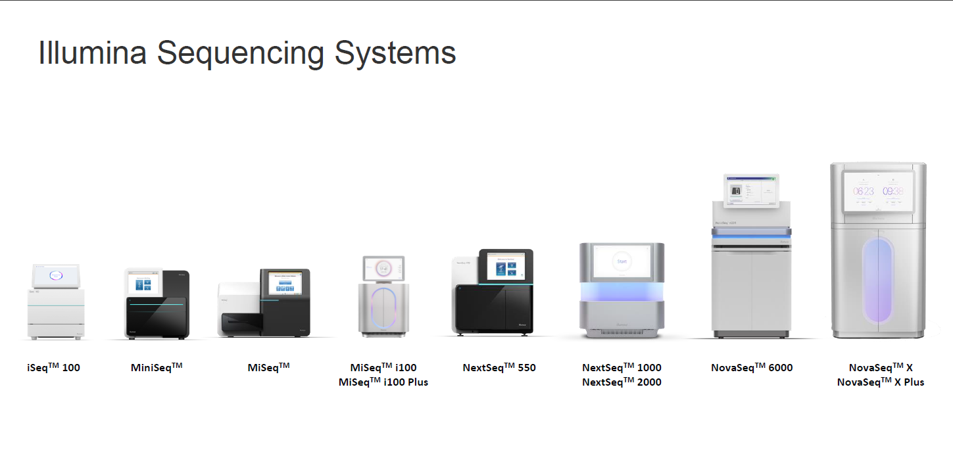

Slide 8
